Slide 1
GP HW11 (CH 14)
Solution

Slide 2
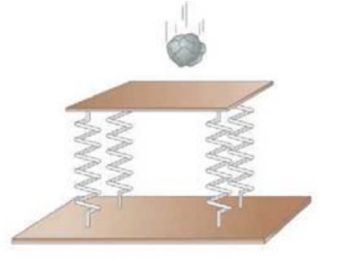
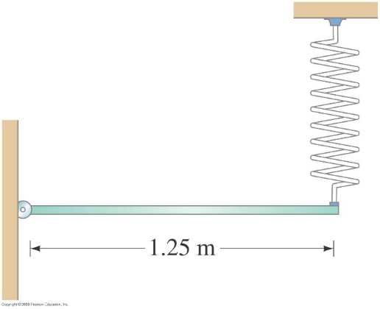
HW11-1: Problem 14-83 in Giancoli (pp. 393)
A 1.6-kg table is supported on four springs. A 0.8-kg chunk of modeling clay is held above the table and dropped so that it hits the table with a speed of 1.65m/s (Fig. below). The clay makes an inelastic collision with table, and clay oscillates up and down. After a long time, the table comes to rest 6.0 cm below its original position.
What is the effective spring constant of all four springs taken together?
(b) With what maximum amplitude does the platform oscillate?
HW11-2: Problem 14-11 in Giancoli (pp. 389)
A uniform meter stick of mass M is pivoted on a hinge at one end and held horizontal by a spring with spring constant k attached at the other end (Fig. 14–28). If the stick oscillates up and down slightly, what is its frequency?
[Hint: Write a torque equation about the hinge.]
HW11-3: Problem 14-84 in Giancoli (pp. 393)
In some diatomic molecules, the force each atom exerts on the other can be approximated by F= -C/r² + D/r³, where r is the atomic separation and C and D are positive constants.
Graph F vs. r from r = 0.8D/C to r = 4D/C
(b) Show that equilibrium occurs at r = r₀ = D/C
(c) Let Δr = r - r₀ be a small displacement from equilibrium, where Δr << r₀. Show that for such small displacements, the motion is approximately simple harmonic, and (d) determine the force constant.
(e) What is the period of such motion?
[Hint: Assume one atom is kept at rest.]

Slide 3

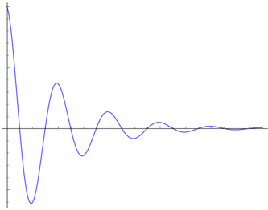
HW11-1: Problem 14-83 in Giancoli (pp. 393)
先畫圖(略圖)以理解問題
(彈簧沒有板子時的高度)
(板子造成的形變量)
(只有板子的平衡點)
(球造成的形變量)
(加上球的平衡點)
(所求,最大振福)
(地板)
黏在一起後的震盪:

Slide 4
(a):
(b):
黏在一起後的瞬間:
最大震幅,
即考慮動能、重力位能轉換成彈力位能
最低點動能為零

Slide 5
先考慮碰撞(完全非彈性碰撞)時間甚短,所以動量變化量可忽略,即動量守恆:
力學能守恆:
所求為R ,將等式整理,並用一元二次公式解, 得

Slide 6
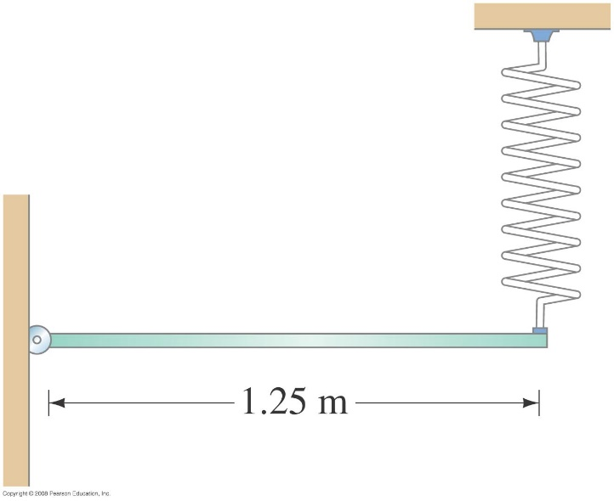
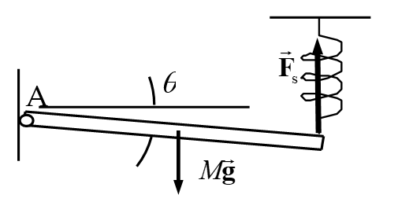
HW11-2: Problem 14-11 in Giancoli (pp. 389)
A uniform meter stick of mass M is pivoted on a hinge at one end and held horizontal by a spring with spring constant k attached at the other end (Fig. 14–28). If the stick oscillates up and down slightly, what is its frequency?
[Hint: Write a torque equation about the hinge.]
達平衡時伸長量為y₀，淨力矩：
伸長y時力矩：
偏移角度極小時，由泰勒展開式可得：
將y代回可得：
又
故可得知

Slide 7
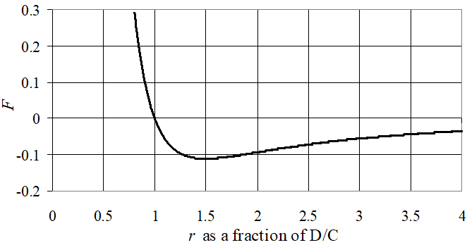
HW11-3: Problem 14-84 in Giancoli (pp. 393)
In some diatomic molecules, the force each atom exerts on the other can be approximated by F= -C/r² + D/r³, where r is the atomic separation and C and D are positive constants.
Graph F vs. r from r = 0.8D/C to r = 4D/C
(b) Show that equilibrium occurs at r = r₀ = D/C
(c) Let Δr = r - r₀ be a small displacement from equilibrium, where Δr << r₀. Show that for such small displacements, the motion is approximately simple harmonic, and (d) determine the force constant.
(e) What is the period of such motion?
[Hint: Assume one atom is kept at rest.]
(b) 平衡時 F = 0
(a)
此結果與(a)相符
(c)

Slide 8
(c)因為F正比於位移 ，且兩者方向相反（差一負號），所以此為簡諧運動。
(d)簡諧運動： ，其中k為彈性常數，故可得
(e)由課本Eq.14-7b ( P.374 )，可得

